Slide 1

NSG Pilkington – University of Liverpool Machine Learning Project: 03/06/2021
Dr. Peter Green
Diego Echeverria
Sarini Jayasinghe
Risk Institute,
School of Engineering

Slide 2
Today
Content:
MK4 Scanner Data
GP Regression
Upskilling:
Linear regression
How do we learn ‘online’?
What actually is a Neural Network?
What is a Gaussian Process?
How does PCA work?
Shannon Entropy?

Slide 3
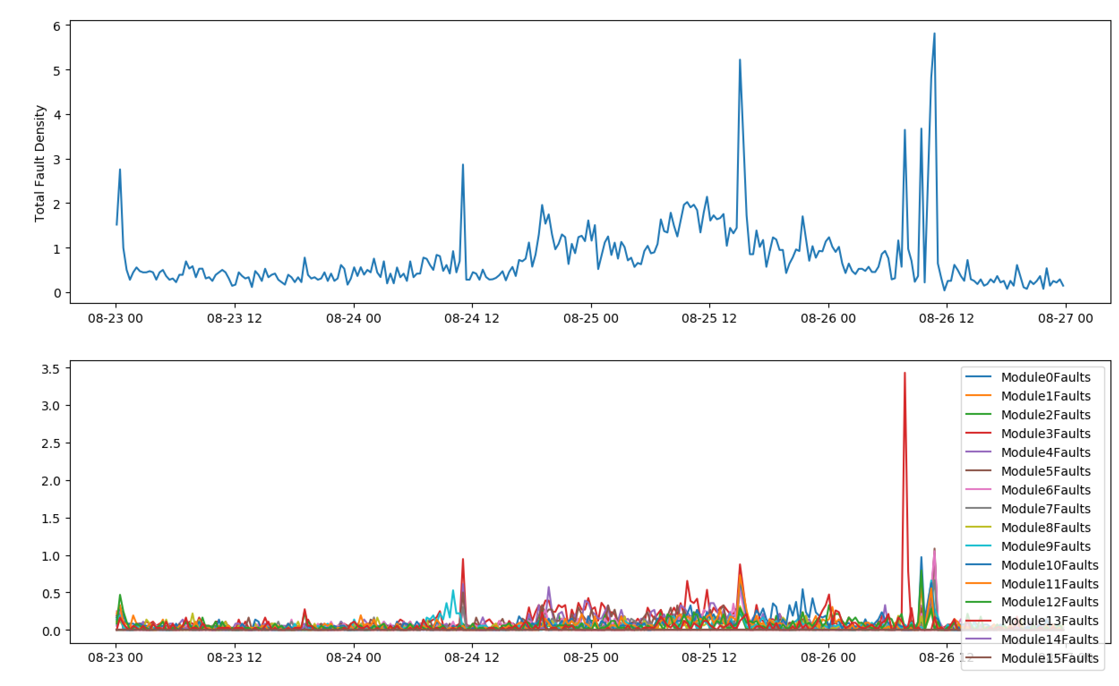
MK4 Fault Scanner Data

Slide 4
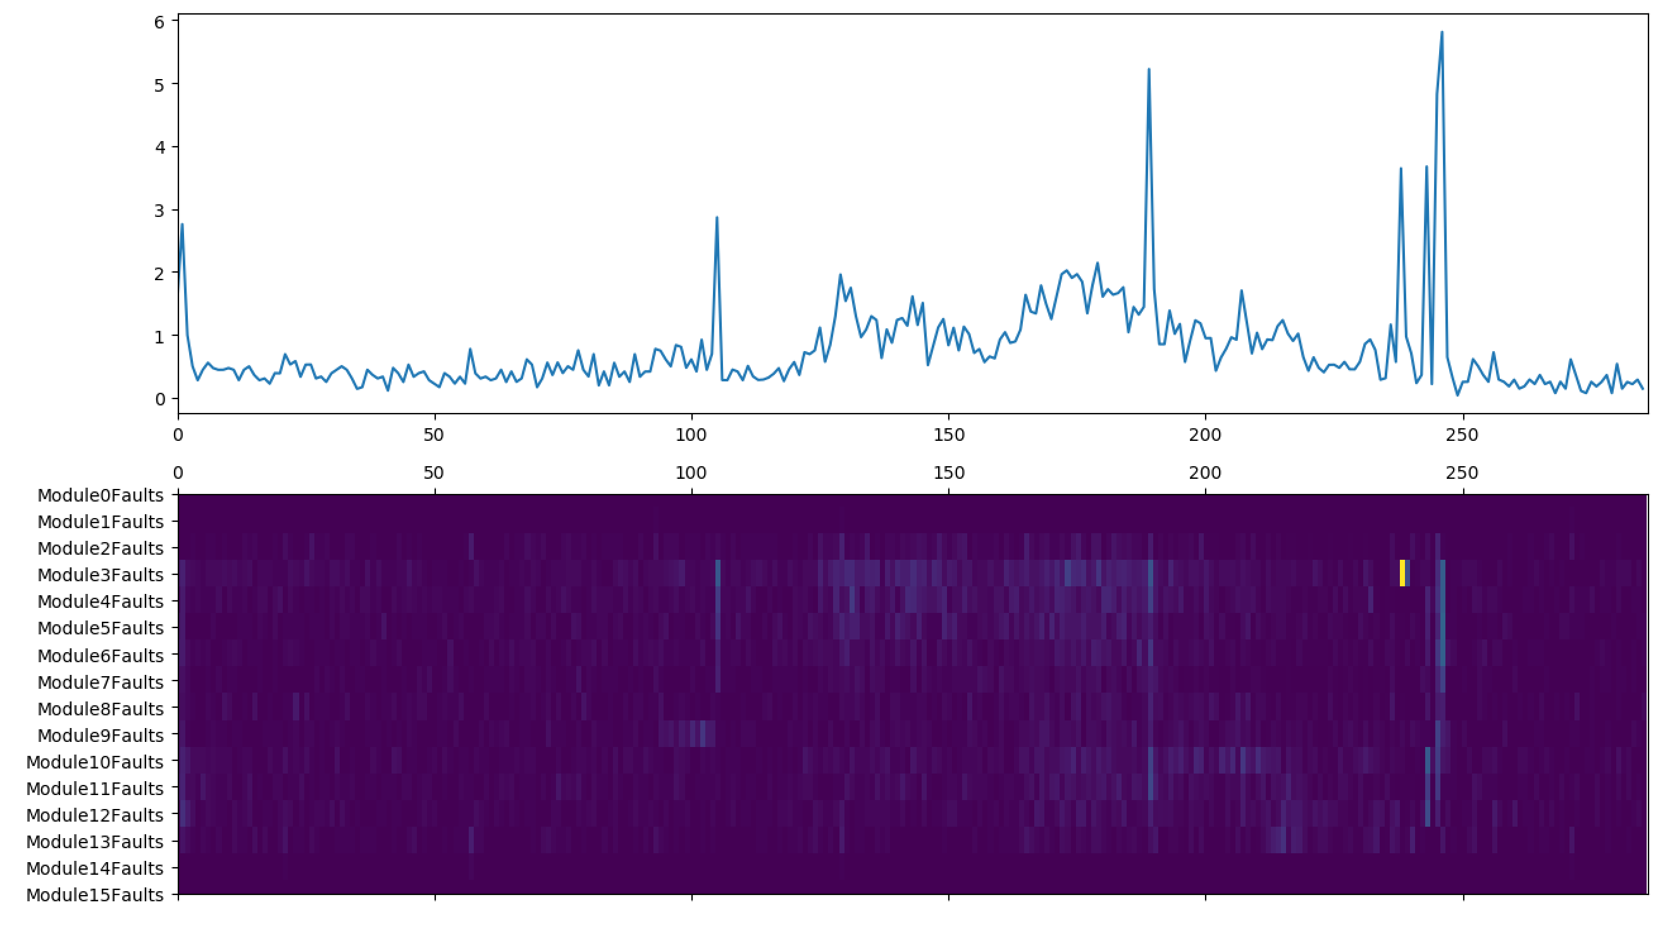
MK4 Fault Scanner Data
In the following, values above 3 now automatically set equal to zero.

Slide 5
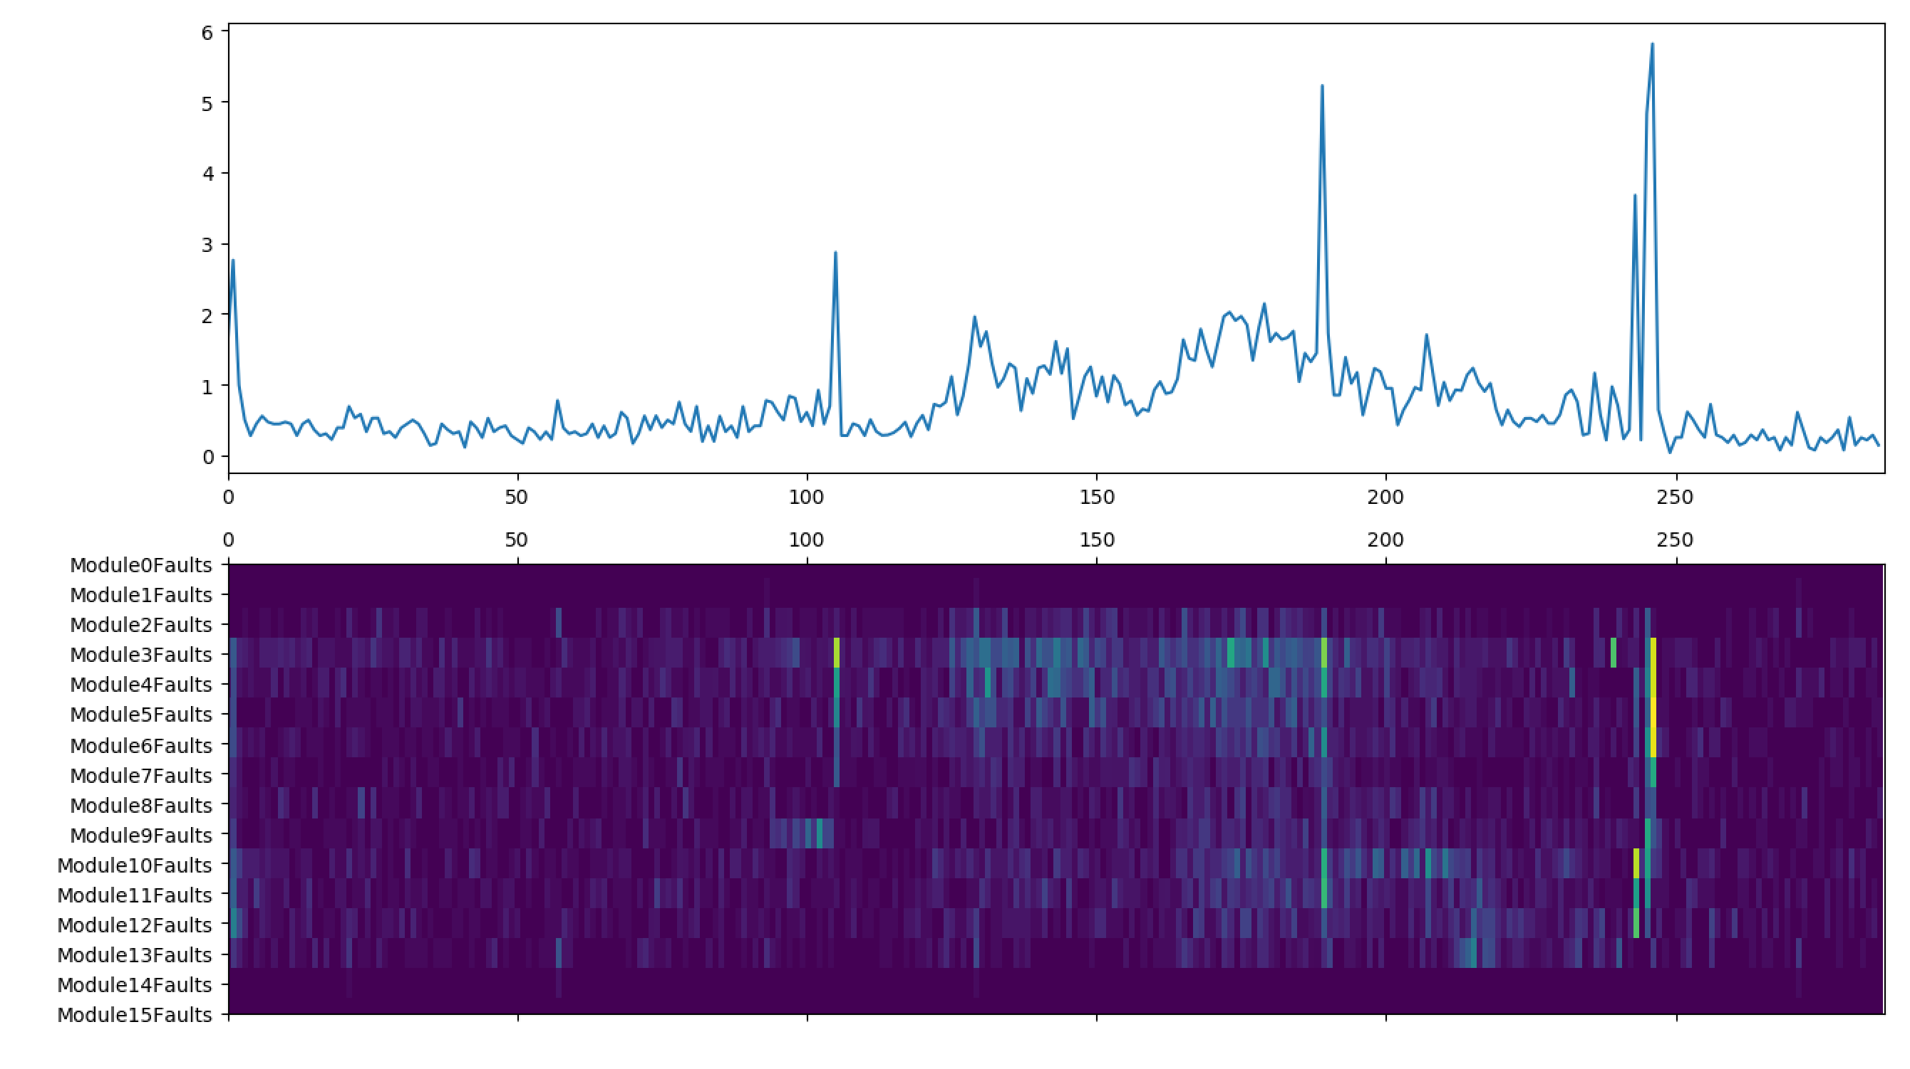
MK4 Fault Scanner Data

Slide 6
MK4 Fault Scanner Data
Module 0 and 15 always equal to zero – correct?
‘Stripes’

Slide 7
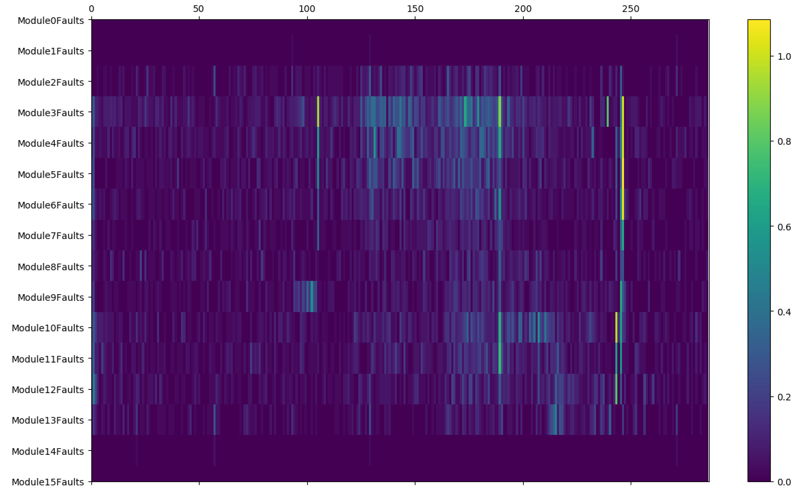
MK4 Fault Scanner Data
(Plotted with colour bar.)

Slide 8
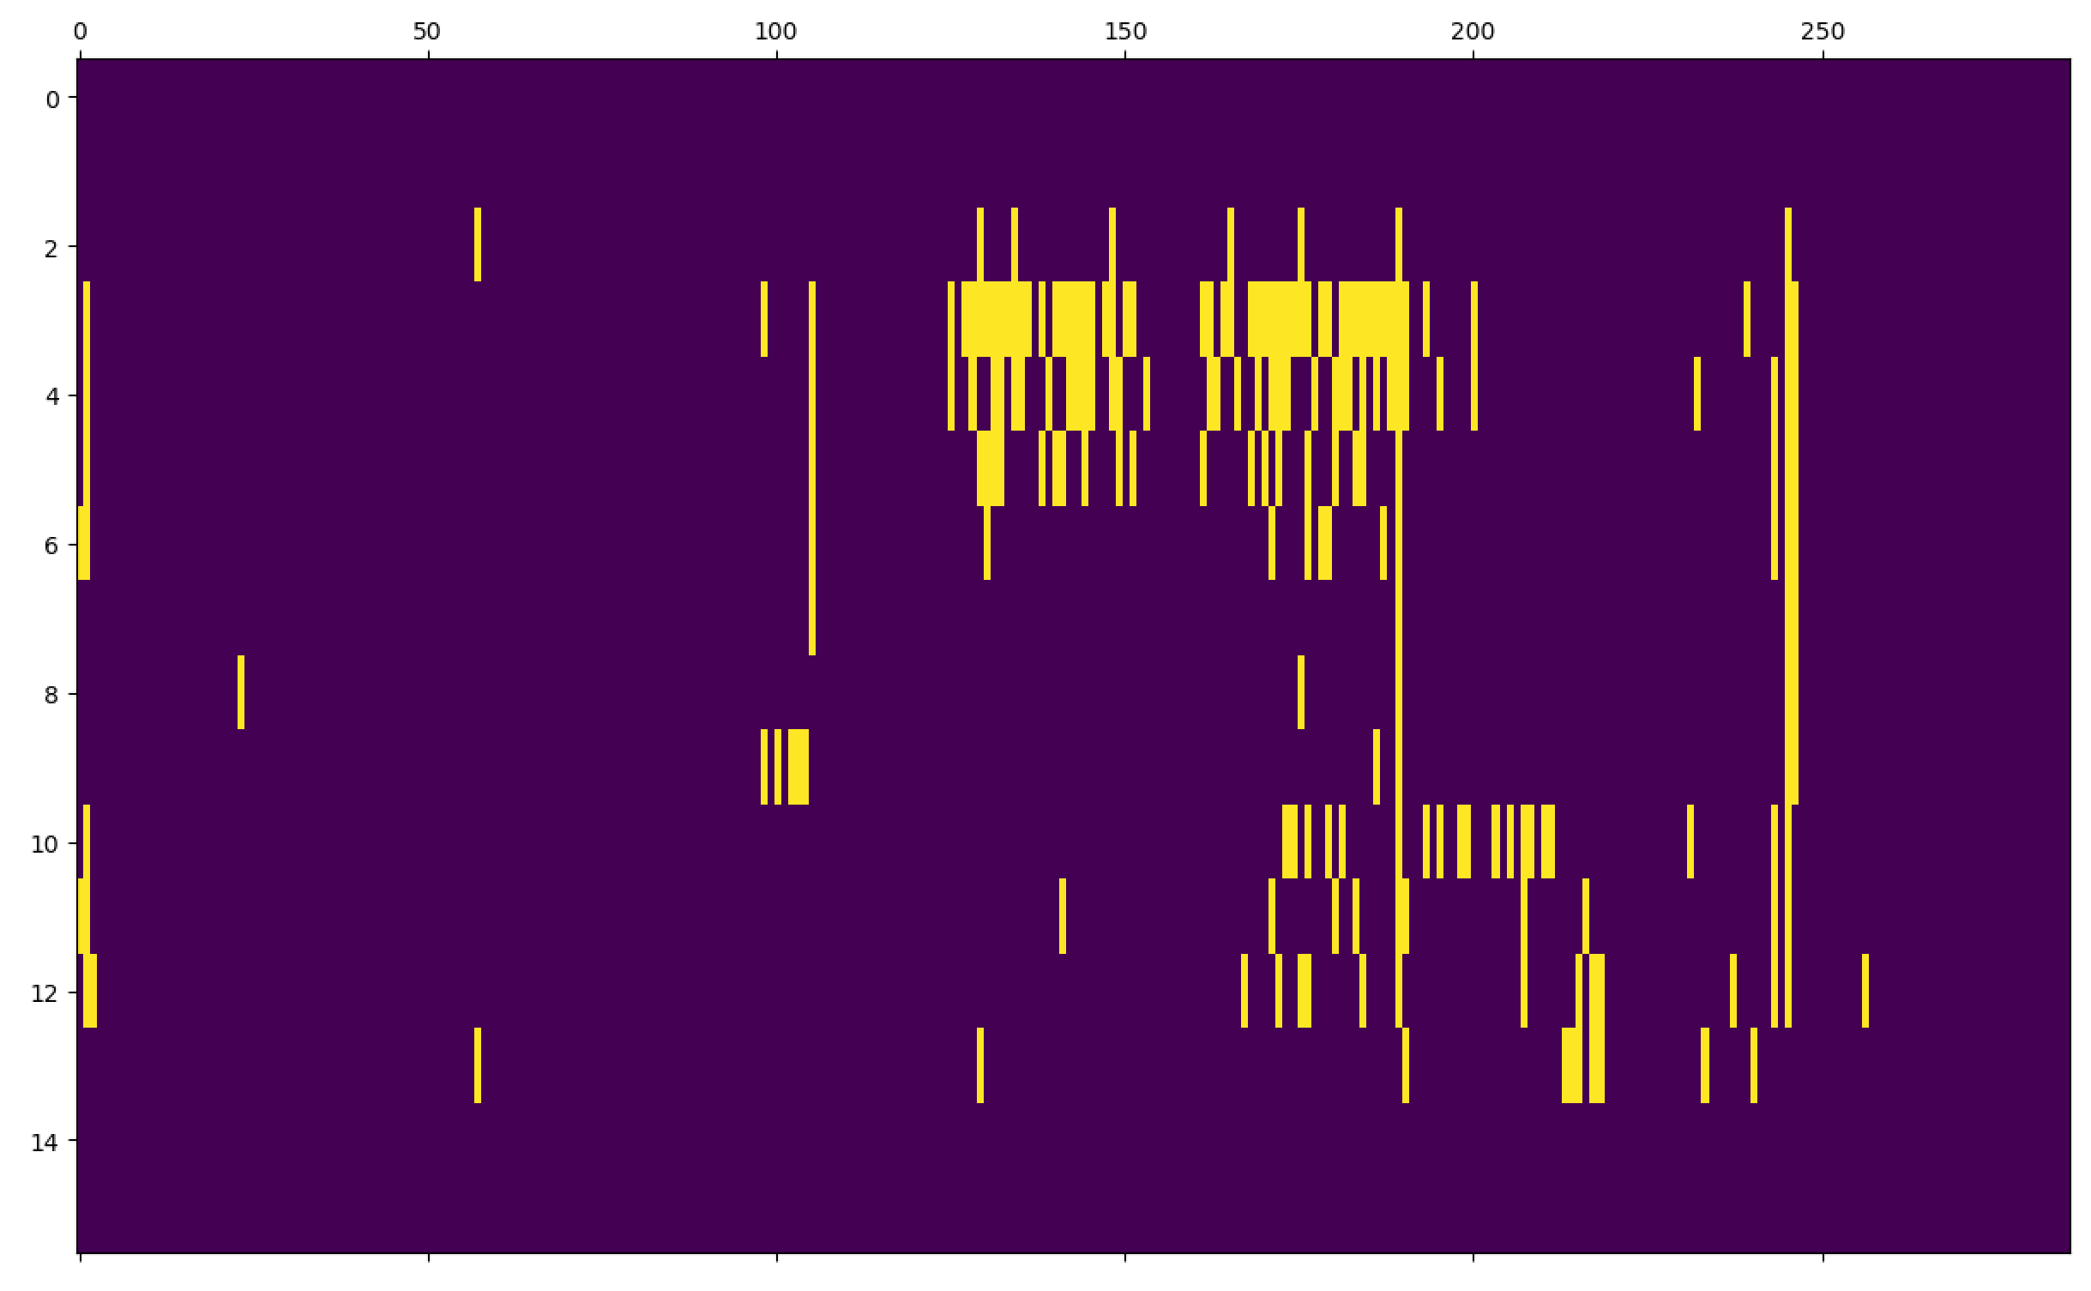
MK4 Fault Scanner Data
Binary representation (1 if faults > 0.2 and 0 otherwise).
Is still difficult to automatically difficult distinguish ‘stripes’; sometimes they are part of clusters of true fault rises?
Probably need something other than the DBSCAN approach.

Slide 9
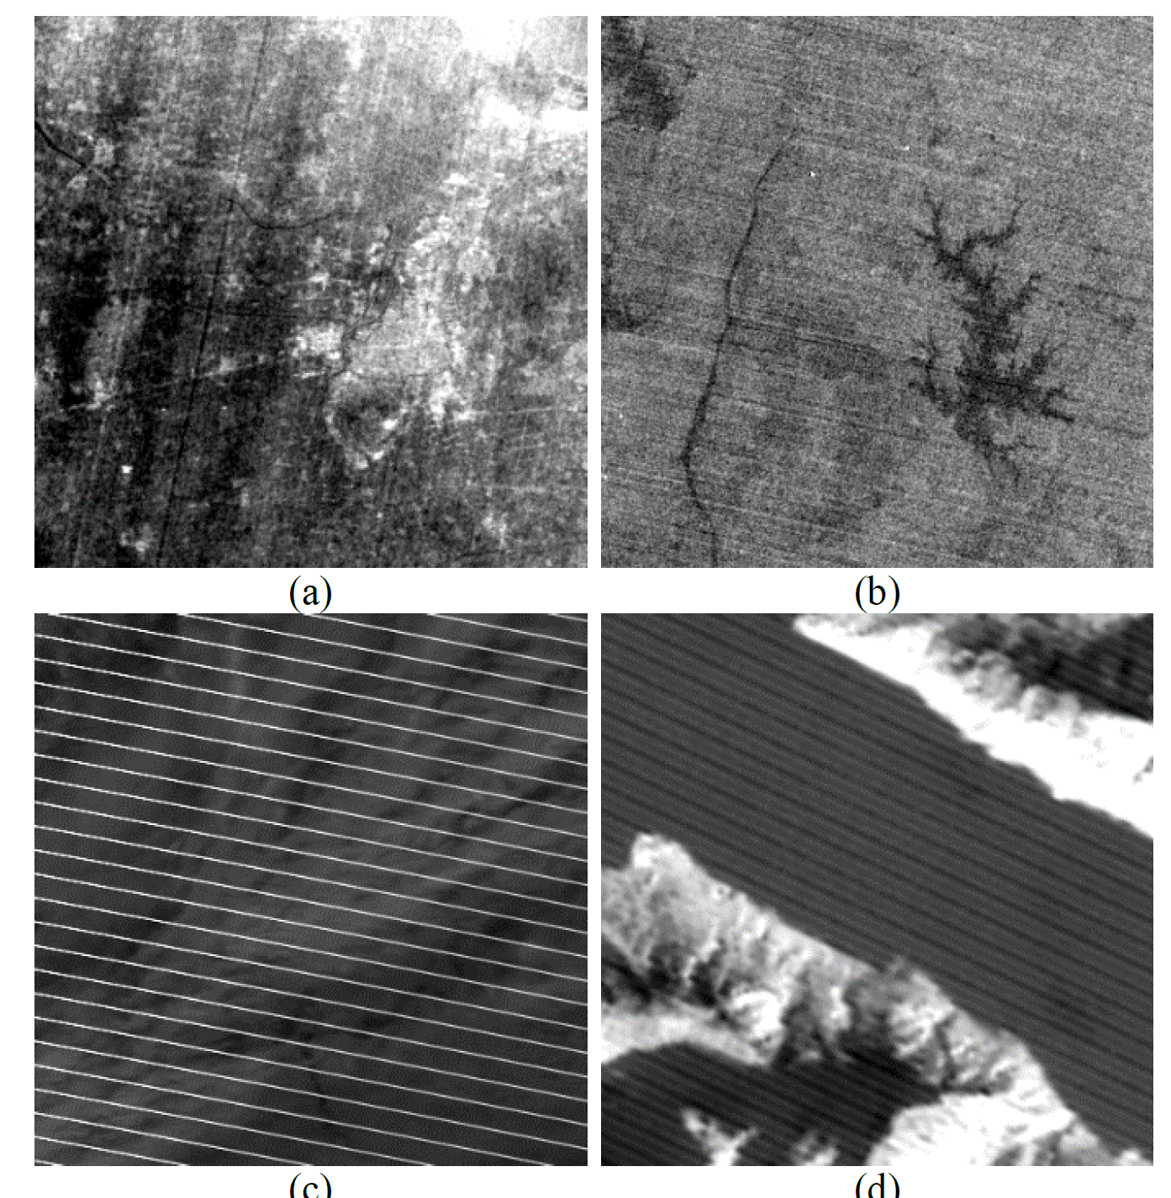
MK4 Fault Scanner Data
From the image processing literature, it looks like we have something similar to ‘stripe noise’ (though it’s occurring for different reasons in our case).
Recent literature [Lie et al., 2018] concerns generic algorithms that can address changes in stripe orientation.
Good news; our stripes are always vertical (for the MK4 at least) so we might be able to lean on some more traditional approaches.
Bad news; our stripes are not periodic, preventing the use of frequency-domain methods like [Pan et al., 1992]. We need a way of measuring ‘uniformity’ across the ribbon…
Liu, X., Lu, X., Shen, H., Yuan, Q., & Zhang, L. (2018). Oblique stripe removal in remote sensing images via oriented variation. arXiv preprint arXiv:1809.02043.
Pan, J. J., & Chang, C. I. (1992). Destriping of Landsat MSS images by filtering techniques. Photogrammetric engineering and remote sensing, 58, 1417-1417.

Slide 10
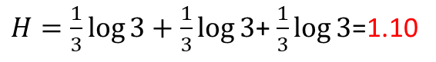
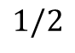
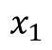
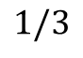
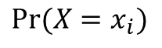
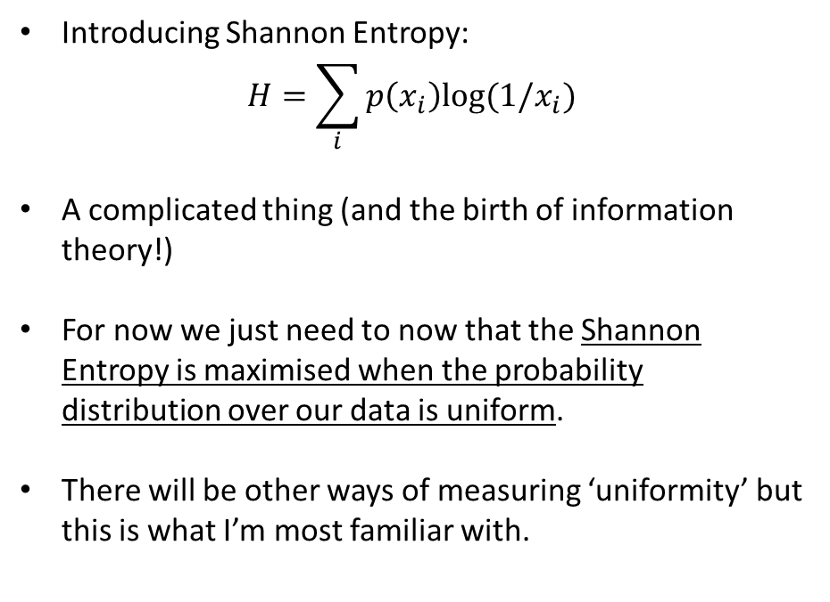
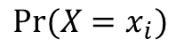
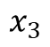
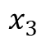
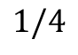
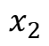
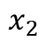
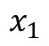
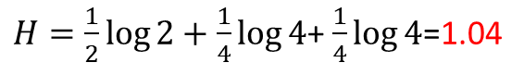
MK4 Fault Scanner Data
$${Pr⁡(X=x}_{i})$$
$$1/3$$
Introducing Shannon Entropy:
$$H=\sum_{i}{p\left(x_{i}\right)log⁡(1/x_{i})}$$
A complicated thing (and the birth of information theory!)
For now we just need to now that the Shannon Entropy is maximised when the probability distribution over our data is uniform.
There will be other ways of measuring ‘uniformity’ but this is what I’m most familiar with.
$$x_{1}$$
$$x_{2}$$
$$x_{3}$$
$H=\frac{1}{3}\log{3}+\frac{1}{3}\log{3}$+ $\frac{1}{3}\log{3}$=1.10
$${Pr⁡(X=x}_{i})$$
$$1/2$$
$$1/4$$
$$x_{1}$$
$$x_{2}$$
$$x_{3}$$
$H=\frac{1}{2}\log{2}+\frac{1}{4}\log{4}$+ $\frac{1}{4}\log{4}$=1.04

Slide 11
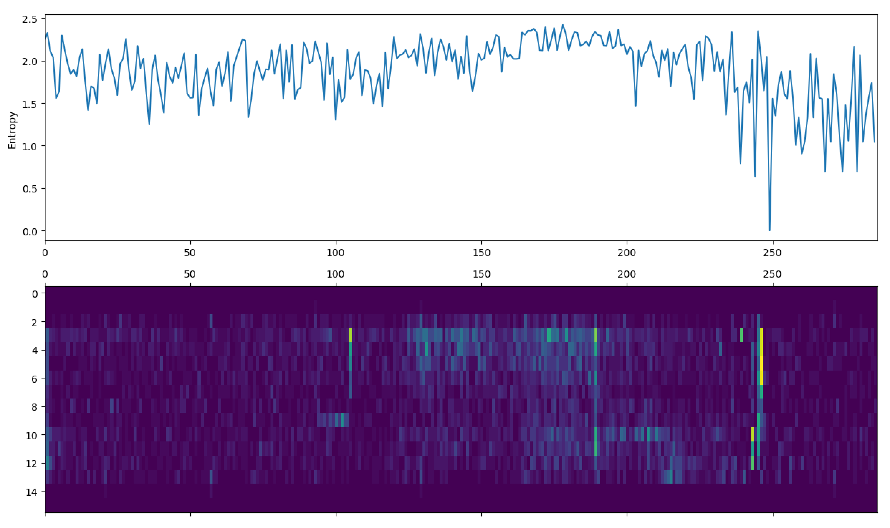
MK4 Fault Scanner Data
The problem here is that low fault density readings are also very uniform.
Perhaps the criteria for a ‘stripe’ should be ‘high fault density and uniform’?

Slide 12
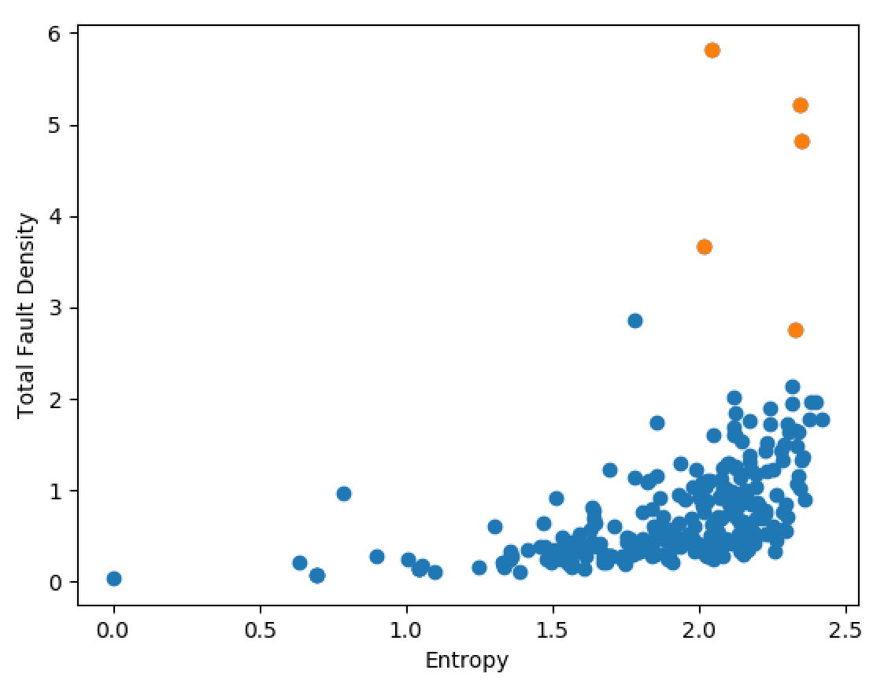
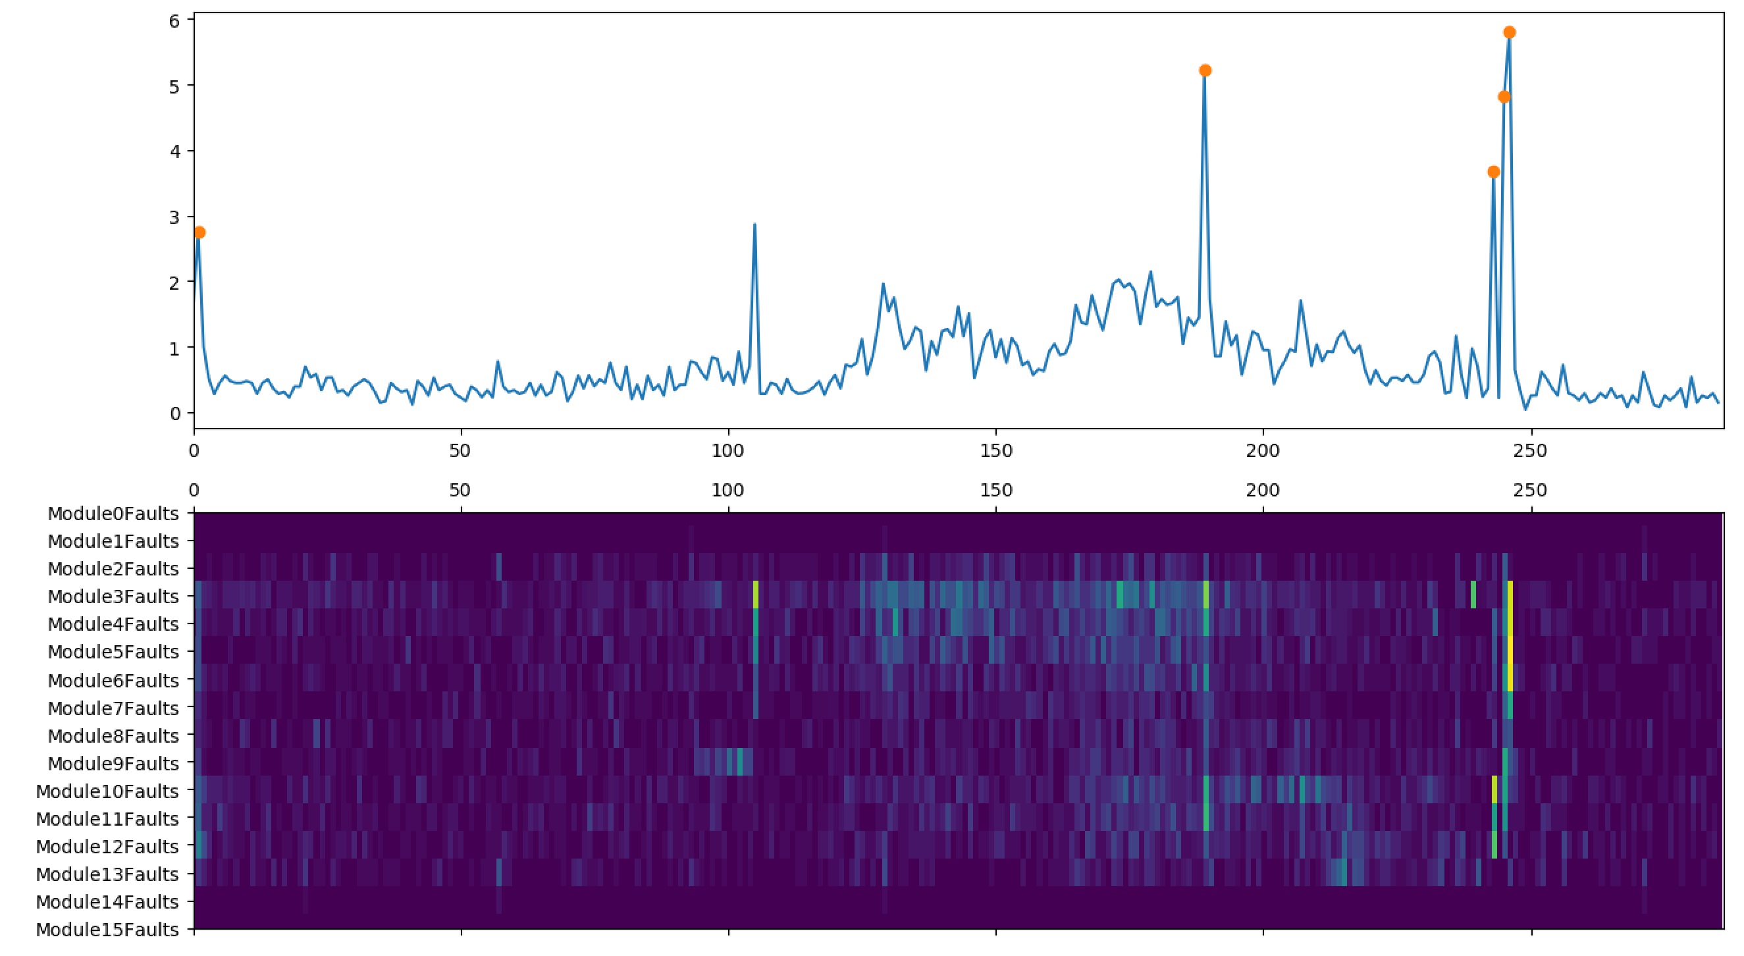
MK4 Fault Scanner Data
For example, here we identify points that have total fault density > 2.5 and entropy > 2
A ‘spike’ but not a ‘stripe’!

Slide 13
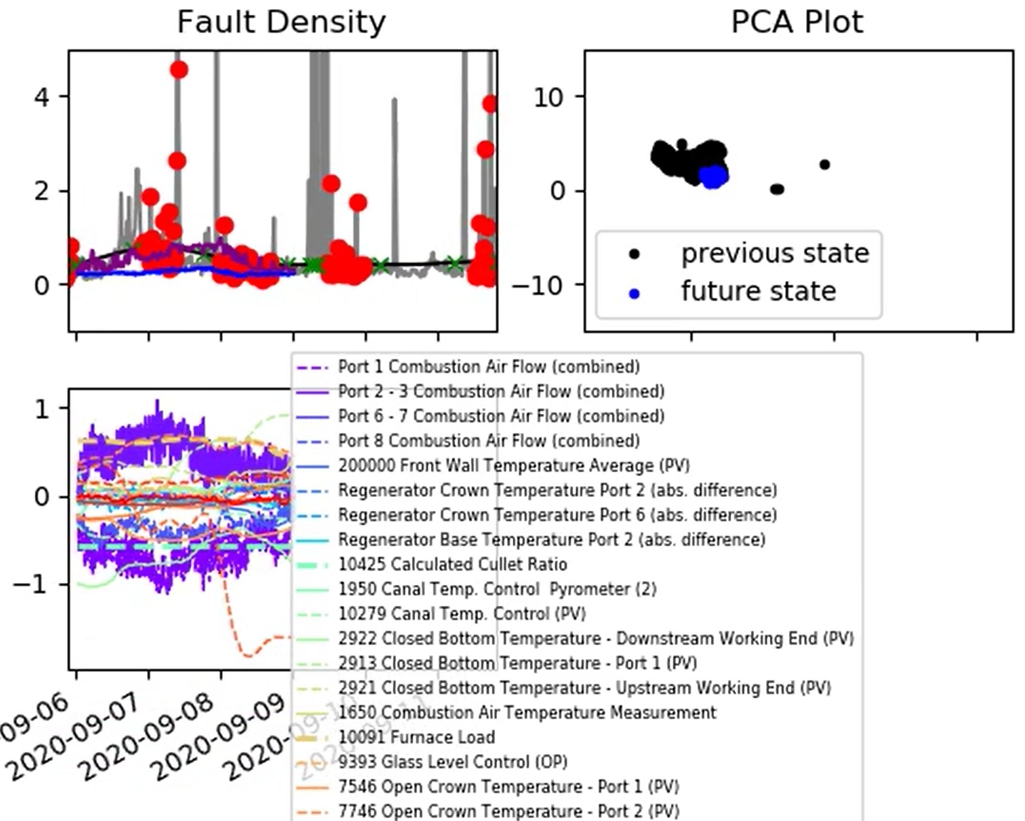
MK4 Fault Scanner Data
Looking over a new date range (2020-09-06 to 2020-09-11)

Slide 14
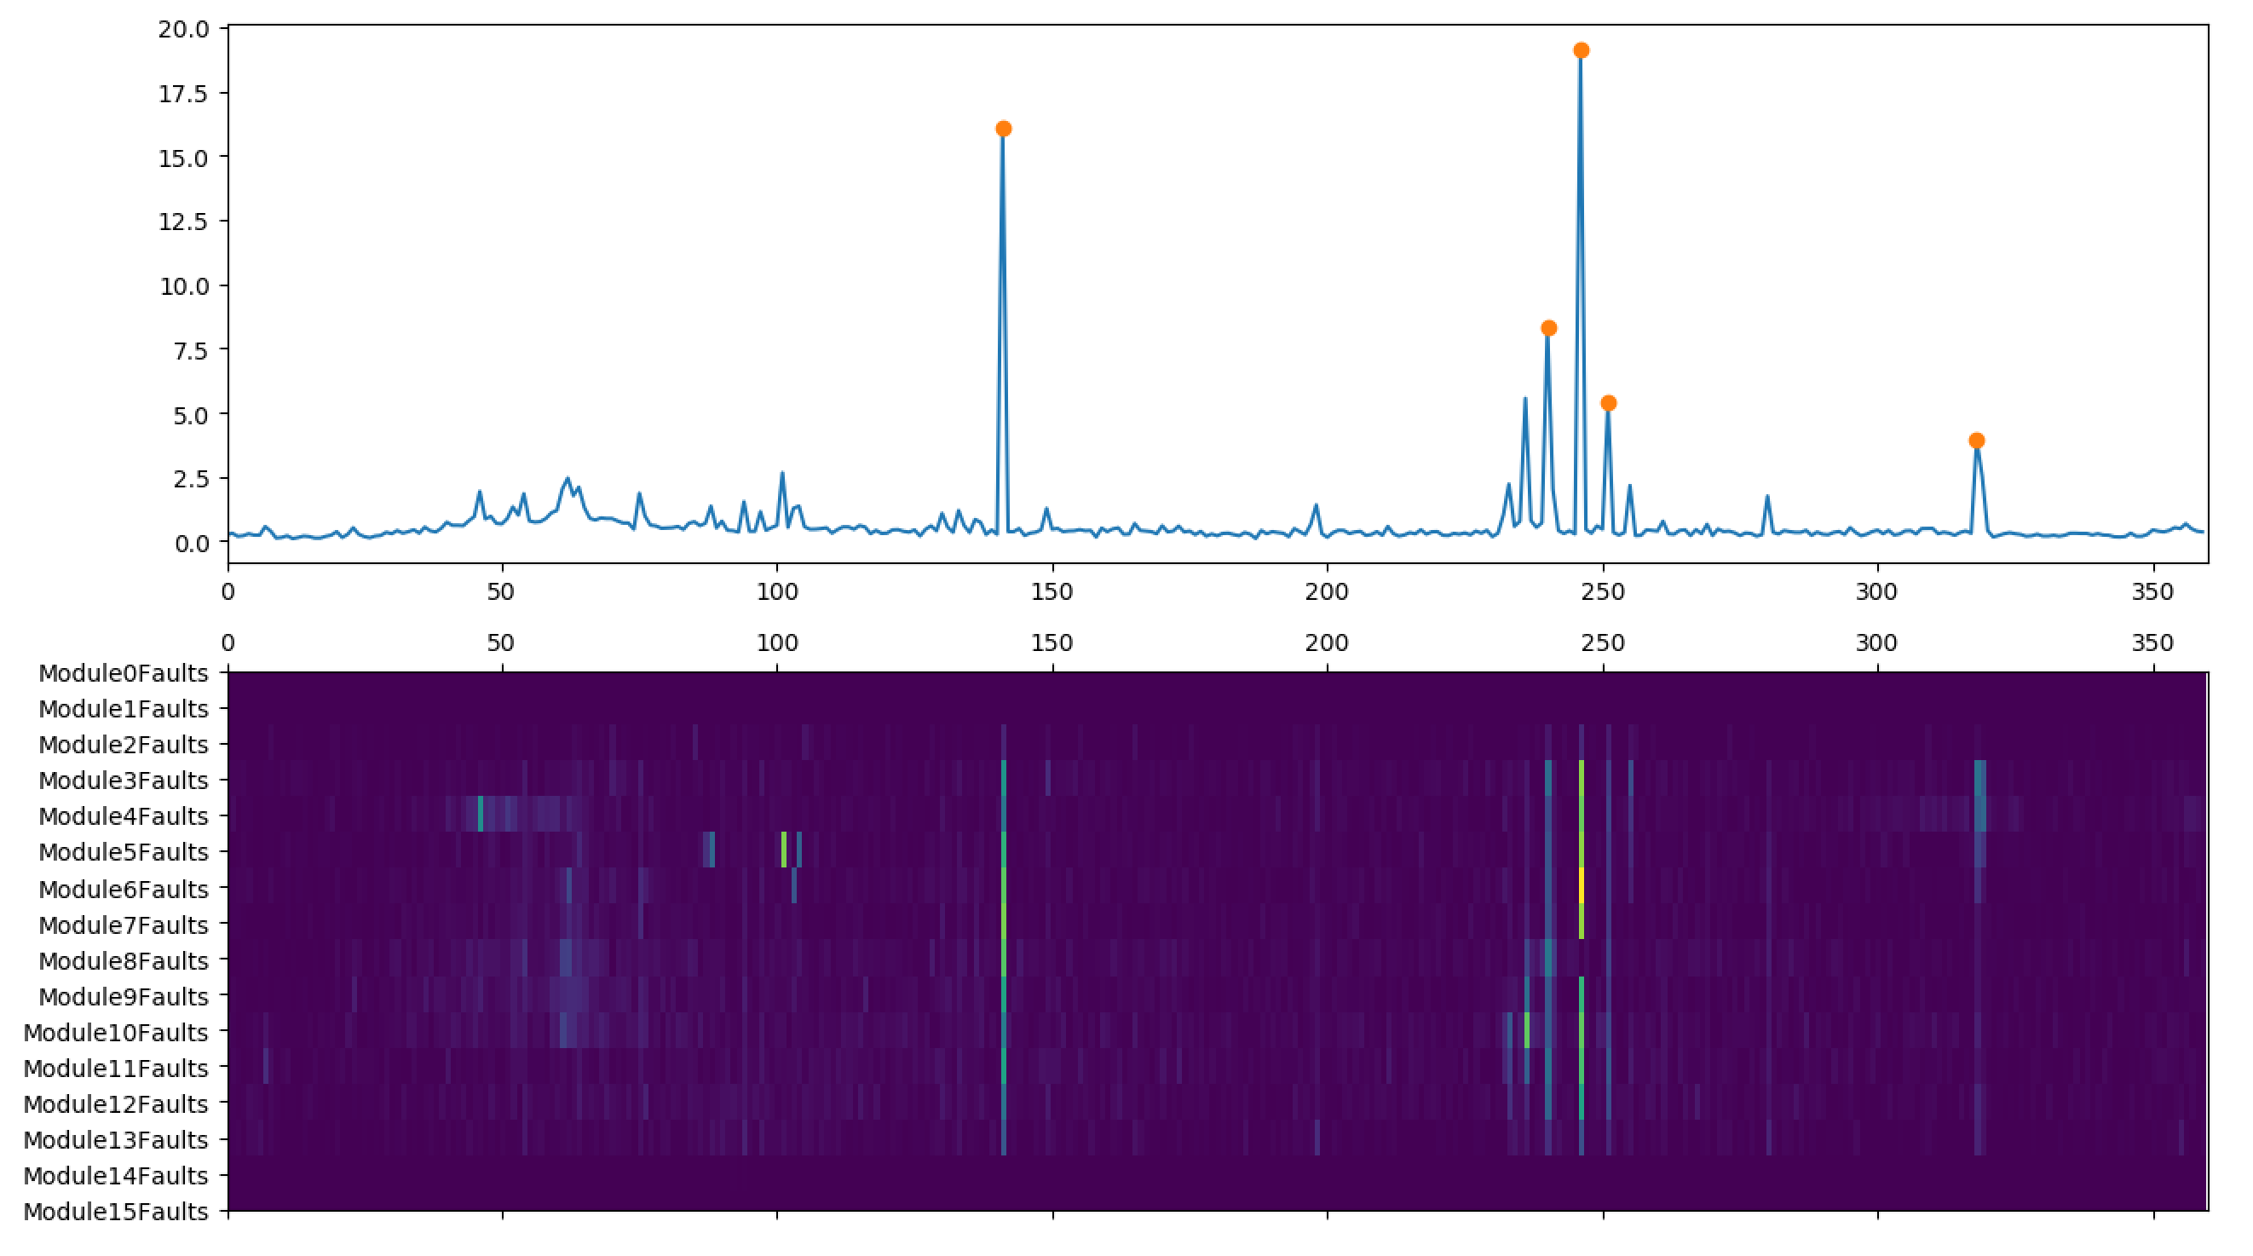
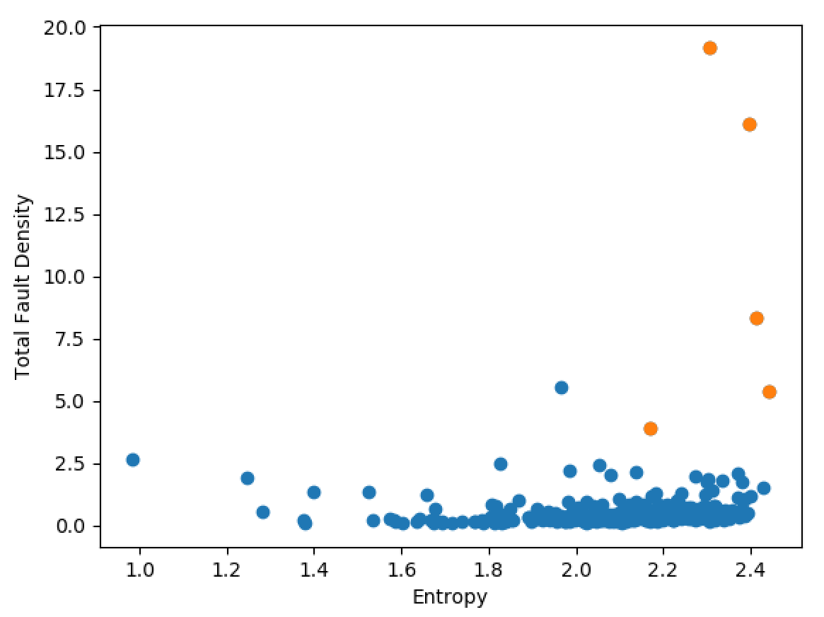
MK4 Fault Scanner Data
Looking over a new date range (2020-09-06 to 2020-09-11)

Slide 15
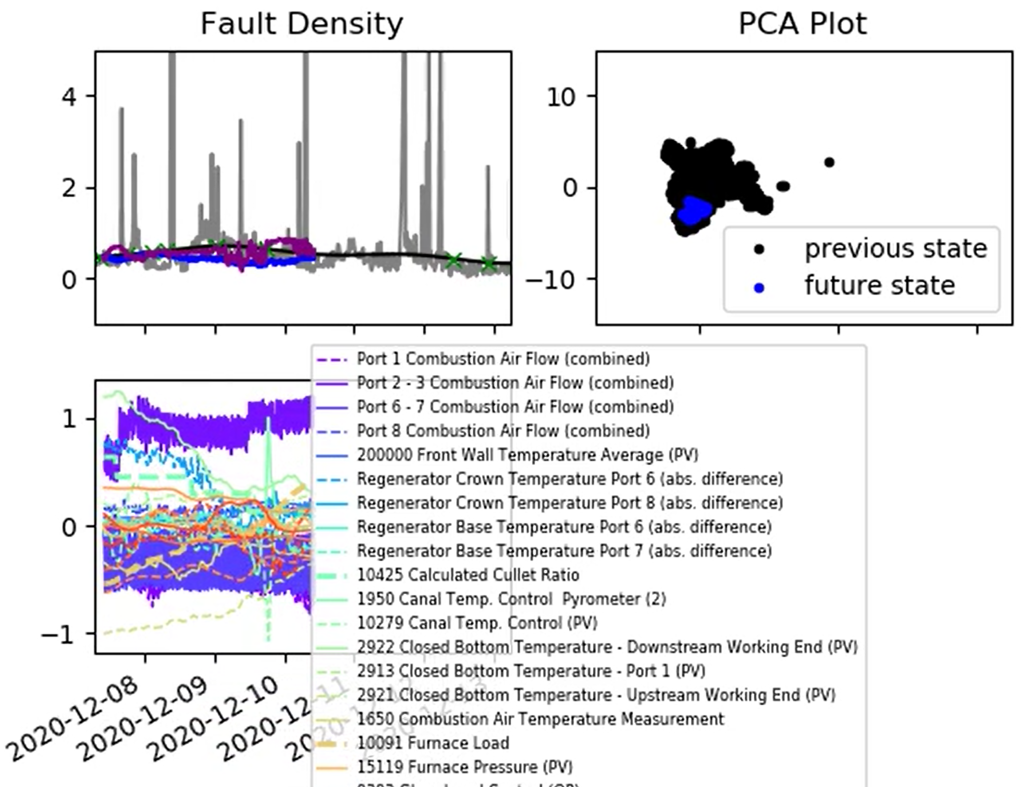
MK4 Fault Scanner Data
Looking over a new date range (2020-12-08 to 2020-12-15)

Slide 16
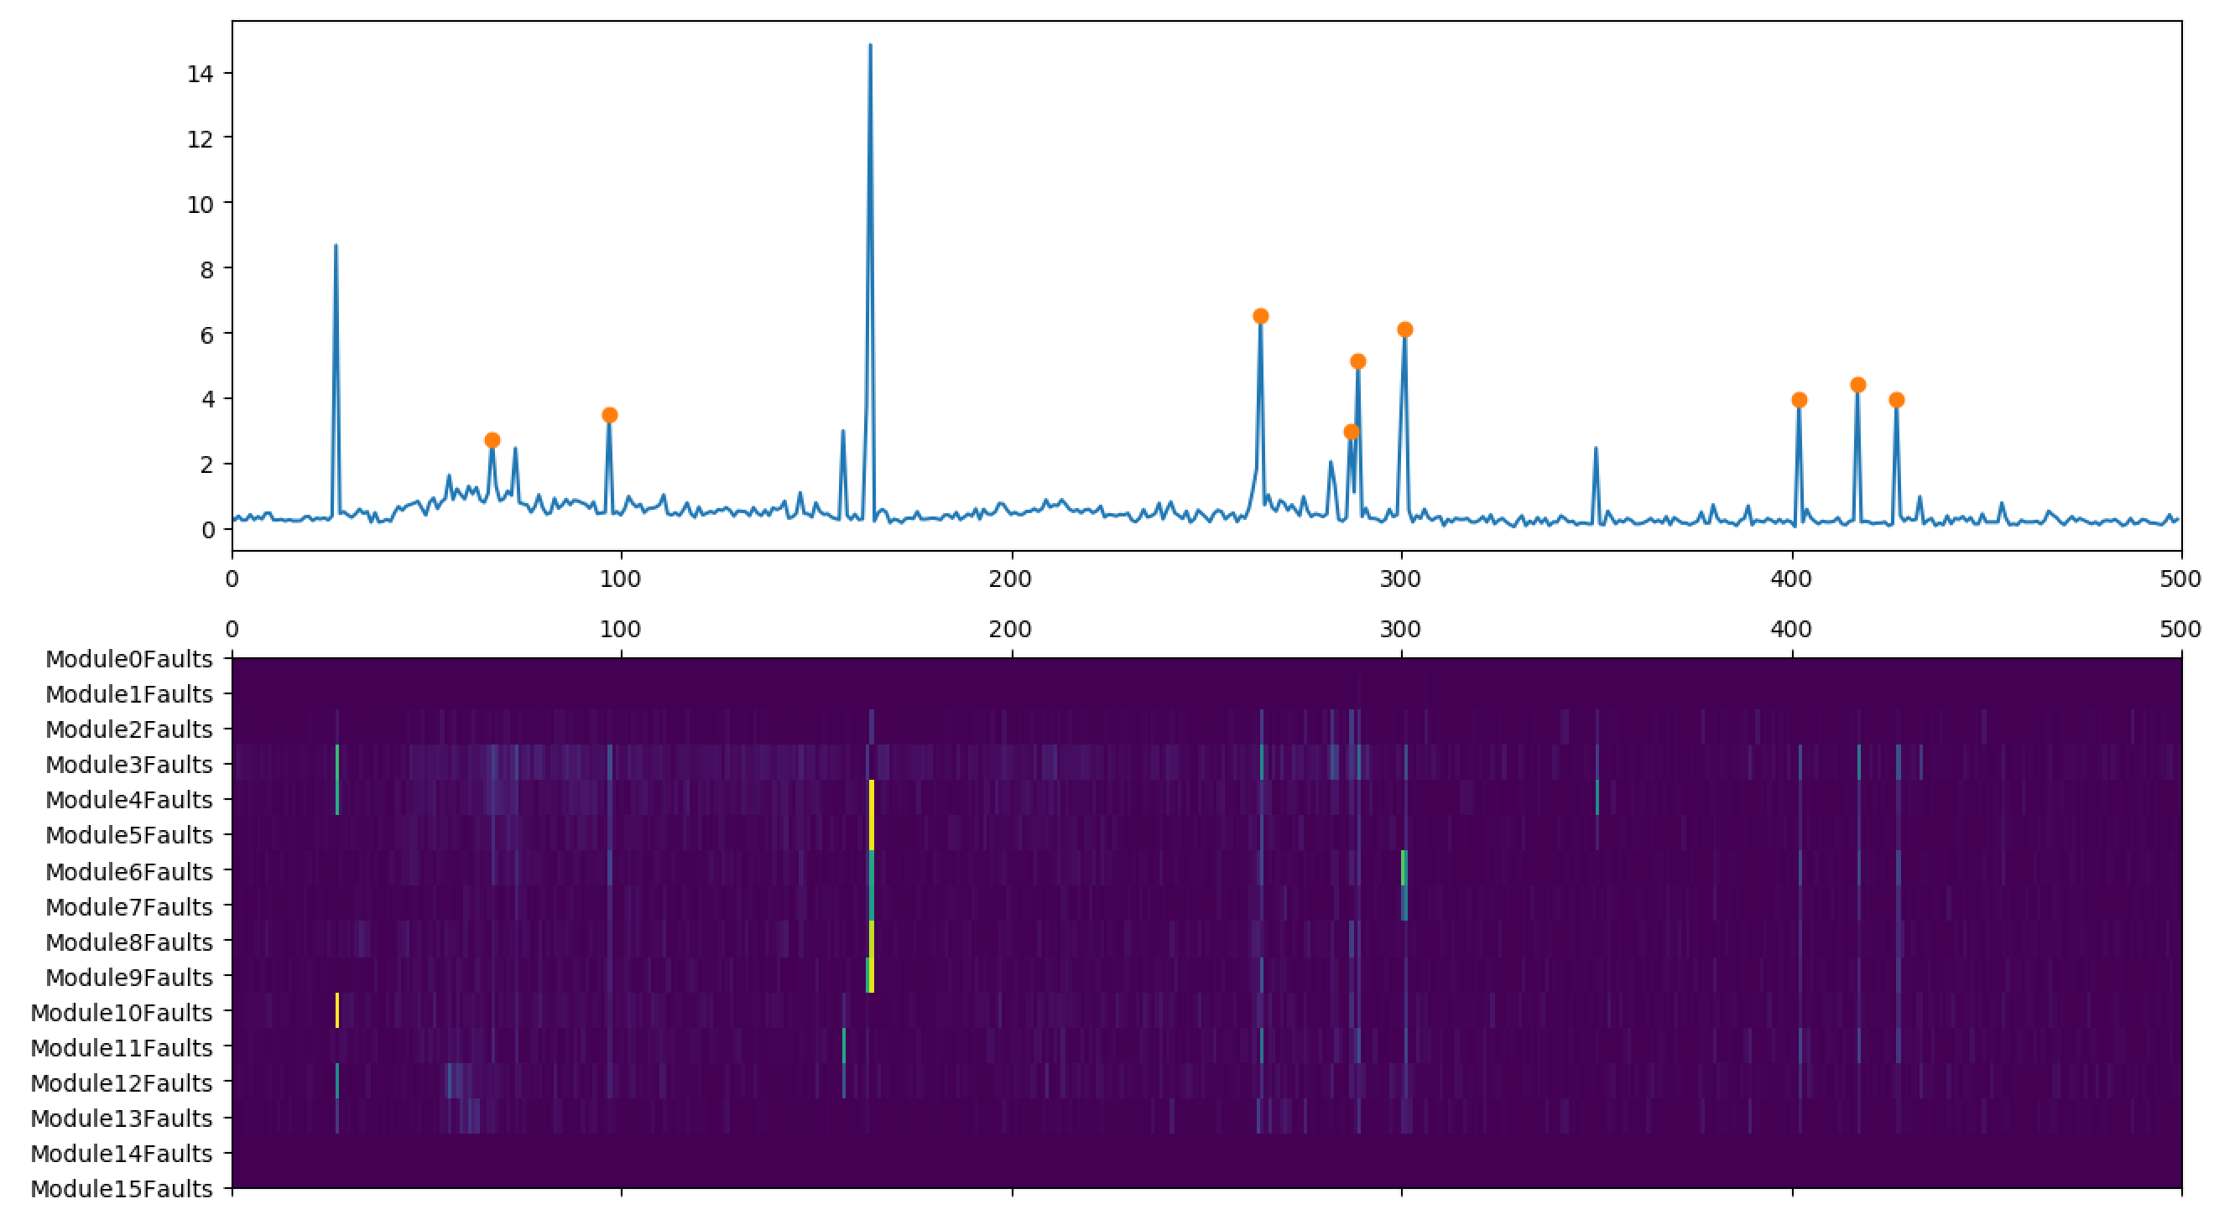
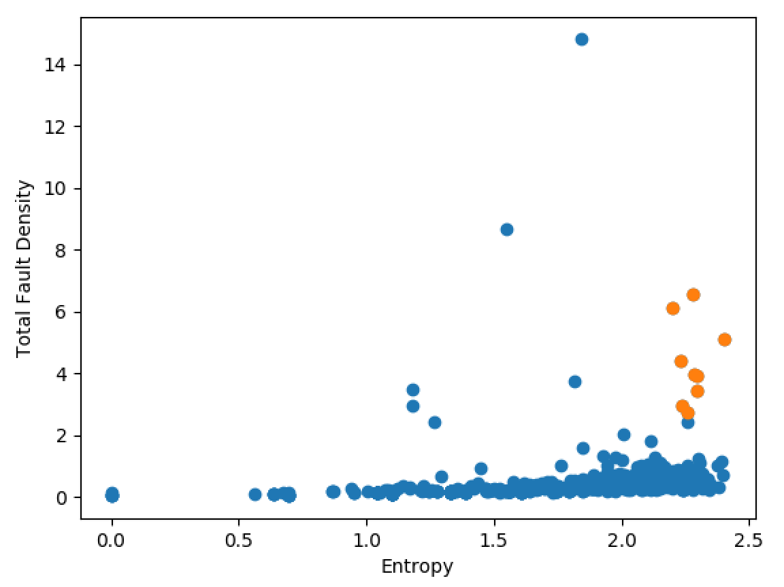
MK4 Fault Scanner Data
Looking over a new date range (2020-12-08 to 2020-12-15)
‘Spike’ but not a ‘stripe’.

Slide 17
MK4 Fault Scanner Data
Are we happy with this definition of ‘stripe’?
Are we happy removing single module values that are higher than some threshold?
What should be do after we’ve deleted the ‘stripes’ (Equal to previous value? Simply ignore?)
Are we comfortable with the ‘spikes not stipes’ (note should hopefully be removed by the spike removal processing that we’re going to the raw data anyway)
The ISRA 5D has horizontal stripes, which is more of a pain; may have to use a sliding window.
For now, would recommend continuing to focus on the MK4 data (focusing on the ISRA later).

Slide 18
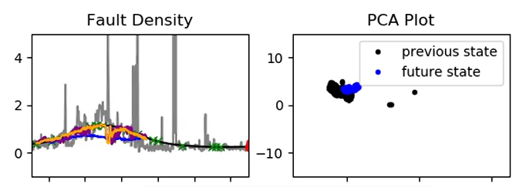
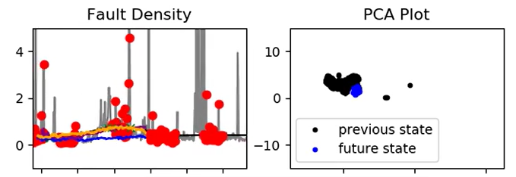
GP Regression
Predicted furnace faults using GP with the reduced input set
Video ‘2021-06-01_results.mp4’ now on the Sharepoint
2020-08-24 to 08-29
2020-09-06 to 09-11

Slide 19
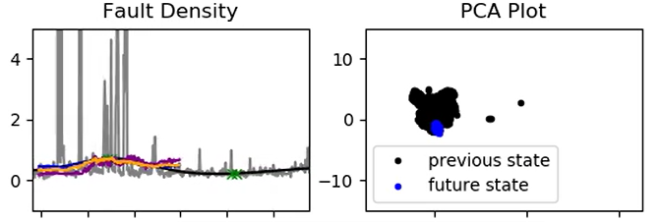
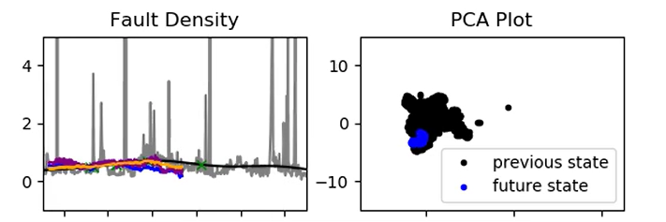
GP Regression
Predicted furnace faults using GP with the reduced input set
Video ‘2021-06-01_results.mp4’ now on the Sharepoint
2020-10-21 to 10-26
2020-12-07 to 12-12

Slide 20
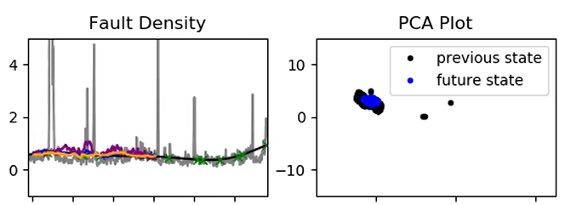
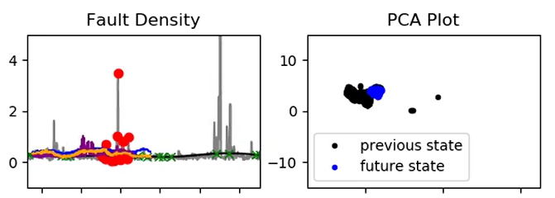
GP Regression
Predicted furnace faults using GP with the reduced input set
Video ‘2021-06-01_results.mp4’ now on the Sharepoint
2020-08-19 to 08-24
2020-08-28 to 09-02

Slide 21
GP Regression
Automatic relevance determination
Inputs | Relevance
10425 Calculated Cullet Ratio | 1.47570386e+07
1950 Canal Temp. Control Pyrometer (2) | 1.91225467e+07
10279 Canal Temp. Control (PV) | 1.84464680e+07
2922 Closed Bottom Temperature - Downstream Working End (PV) | 2.14379498e+07
2913 Closed Bottom Temperature - Port 1 (PV) | 9.52148658e+06
2918 Closed Bottom Temperature - Port 6 (PV) | 6.93637760e+06
2921 Closed Bottom Temperature - Upstream Working End (PV)', | 9.20197318e+06
1650 Combustion Air Temperature Measurement | 6.96598293e-01
10091 Furnace Load | 6.12146795e+06
15119 Furnace Pressure (PV) | 9.84513278e+06
9393 Glass Level Control (OP) | 3.29231329e+06
7546 Open Crown Temperature - Port 1 (PV) | 1.46498971e+07
7746 Open Crown Temperature - Port 2 (PV) | 4.88885491e+06
7673 Open Crown Temperature - Port 5 (PV) | 1.05928824e+07
7483 Open Crown Temperature - Port 6 (PV) | 3.73334813e+06
10271 Open Crown Temperature - Upstream Refiner (PV) | 1.13782346e+07
7520 Open Crown Temperature - Upstream Working End (PV) | 4.75003849e+06
9400 Port 2 Gas Flow (SP) | 3.23756224e+06
9282 Tweel Position | 1.03640068e+07

Slide 22
GP Regression
Automatic relevance determination
Inputs | Relevance
11384 Wobbe Index (Incoming Gas)' | 1.39070006e+07
Port 1 Combustion Air Flow (combined) | 1.29692822e+07
Port 2 - 3 Combustion Air Flow (combined) | 5.90208783e-01
Port 4 - 5 Combustion Air Flow (combined) | 1.88644639e+00
Port 6 - 7 Combustion Air Flow (combined | 2.53016657e+00
Port 8 Combustion Air Flow (combined) | 4.01497482e+06
200000 Front Wall Temperature Average (PV) | 6.70581206e+06
Regenerator Crown Temperature Port 2 (abs. difference) | 1.07234578e+00
Regenerator Crown Temperature Port 4 (abs. difference) | 7.31755158e+00
Regenerator Crown Temperature Port 6 (abs. difference) | 8.89175497e+06
Regenerator Crown Temperature Port 8 (abs. difference) | 1.53359477e+00
Regenerator Base Temperature Port 1 (abs. difference) | 2.32852629e+06
Regenerator Base Temperature Port 2 (abs. difference) | 7.52222678e+06
Regenerator Base Temperature Port 3 (abs. difference) | 1.36922676e+00
Regenerator Base Temperature Port 4 (abs. difference) | 1.17411183e+00
Regenerator Base Temperature Port 5 (abs. difference) | 9.08598670e+06
Regenerator Base Temperature Port 6 (abs. difference) | 7.60579741e-01
Regenerator Base Temperature Port 7 (abs. difference) | 4.29270772e+06
Regenerator Base Temperature Port 8 (abs. difference) | 5.21612825e+06

Slide 23
Next Steps
Decide on (and implement) strategy for MK4 Scanner Data
GP Regression:
Lower relevance inputs removed
Confidence bounds
Model applied to new data

Slide 24
Thank you for your attention. ANY QUESTIONS?

